Slide 1
Inventory control

Slide 2
Materials Management
Materials are key resource in an industrial enterprise
Production is not possible without materials
Materials cost is major constitute of the cost of the product
Proper control over material purchase, storage, issue, movement and consumption is necessary. Materials management does this for enterprise

Slide 3
Materials Management
Material Management Definition
“ Materials Management is the planning and control of the flow of materials that are part of inbound logistics system”
- A total concept involving an organization structure unifying into single responsibility for the systematic flow and control of materials from identification of need through usage and according of the same.

Slide 4
Materials Management : Objectives
Support operational requirement
Manage the material process efficiently and effectively
Select, develop and maintain sources of supply
Develop strong relationships with other groups
Support organizational goals
Develop integrated strategies that support organizational goals

Slide 5
Scope of Material Management
Material requirement planning and control
Procurement
Inventory Control
Receiving and inspection
Transportation
Material handling
Dispatch of material
Value analysis

Slide 6
Responsibilities of Materials management
Cost reduction
Optimum service level
Quality Assurance
Low level of capital tied up

Slide 7
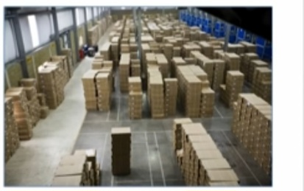
What is Inventory?
Stock of items kept to meet future demand
Purpose of inventory Management
- How many units to order
-When to order

Slide 8
Components of Inventory
Raw materials
Purchased parts
Work-in-progress
Items being transported
Tools and equipment

Slide 9
Inventory Control

Slide 10
Need of Inventory
Inventory and supply chain management
Bullwhip effect
- demand information is distorted as it moves away from the end user customer
- Higher safety stock inventories are stored to compensate
Seasonal or cyclical demand
Inventory provides independence from vendors
Take advantage of price discounts
Inventory provides independence between stages and avoids work stoppages.

Slide 11
Inventory Control
Inventory control is planned approach of determining what to order, when to order, how much to order and how much to stock
The cost associated with buying and storing are optimal without interrupting and sales
Inventory control basically deals with two problems
- When should an order be placed?( Order level)
- How much should be ordered ( Order quantity)

Slide 12
Selective control of Inventory
Selective control refers to the variation in method of control from item to item on selective basis
In this system, the items are categorized in few groups depending upon the selected criteria such as value, usage, frequency and consumption
Such grouping helps the organization for scientific inventory control

Slide 13
Various types of analysis
ABC analysis
VED(Vital, essential, Desirable) analysis
HML(High, Medium, Low) analysis

Slide 14
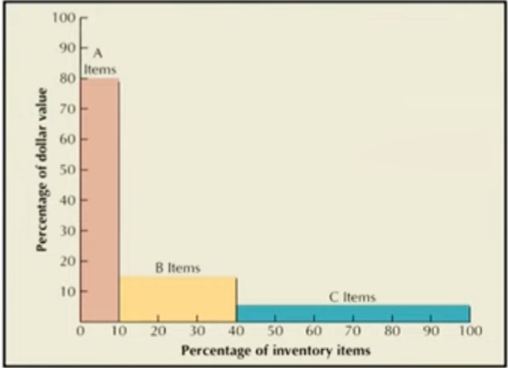
ABC Classification
Classification based on cost and volume
Class A
5-15% units
70-80% of value
Class B
30 % of units
15% of value
Class C
50-60 % of units
5-10 % of value

Slide 15
ABC classification Example
Part | Unit cost | Annual Usage
1 | $60 | 90
2 | 350 | 40
3 | 30 | 130
4 | 80 | 60
5 | 30 | 100
6 | 20 | 180
7 | 10 | 170
8 | 320 | 50
9 | 510 | 60
10 | 20 | 120

Slide 16
Part | Total Value | % of total value | % of total quantity | % cumulative
9 | $30,600 | 35.9 | 6 | 6
8 | 16000 | 18.7 | 5 | 11
2 | 14000 | 16.4 | 4 | 15
1 | 5400 | 6.3 | 9 | 24
4 | 4800 | 5.6 | 6 | 30
3 | 3900 | 4.6 | 10 | 40
6 | 3600 | 4.2 | 18 | 58
5 | 3000 | 3.5 | 13 | 71
10 | 2400 | 2.8 | 12 | 83
7 | 1700 | 2.0 | 17 | 100
 | $85400

Slide 17
Solution
Part | Total Value | % of total value | % of total quantity |  | % cumulative
9 | $30,600 | 35.9 | 6 |  | 6
8 | 16000 | 18.7 | 5 | A | 11
2 | 14000 | 16.4 | 4 |  | 15
1 | 5400 | 6.3 | 9 |  | 24
4 | 4800 | 5.6 | 6 | B | 30
3 | 3900 | 4.6 | 10 |  | 40
6 | 3600 | 4.2 | 18 |  | 58
5 | 3000 | 3.5 | 13 | C | 71
10 | 2400 | 2.8 | 12 |  | 83
7 | 1700 | 2.0 | 17 |  | 100
 | $85400

Slide 18
Class | Items | % of total value | % total quantity
A | 9, 8, 2 | 71.0 | 15.0
B | 1, 4, 3 | 16.5 | 25.0
C | 6, 5, 10, 7 | 12.5 | 60.0

Slide 19
Advantage of ABC analysis
This approach helps the manager to exercise selective control and focus of his attention only on few items
By exercising strict control on A class items, the materials manager is able to show results with the short period of time
It results in reduced clerical cost, saves time and efforts and results in better planning and control

Slide 20
Limitation of ABC analysis
It is not one time exercise and items are to be reviewed and recategorised periodically

Slide 21
V.E.D. ( Vital, Essential, Desirable ) Analysis
The analysis classifies the items into three groups called Vital, essential and desirable.
Vital Items are those items , whose unavailability will stop the production
Essential items are those items, whose stock out costs are very high
Desirable items will not cause any immediate production stoppage and their stock out costs are nominal

Slide 22
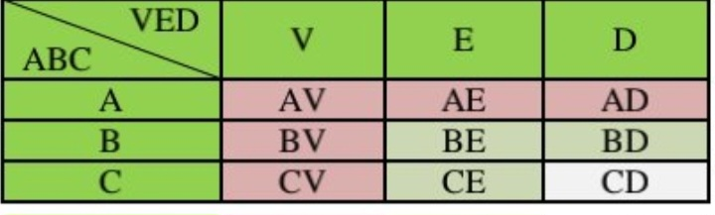
VED- ABC Matrix

Slide 23
Economic order quantity (EOQ) Model
EOQ
- optimal order quantity that will minimize total inventory cost
Basic EOQ Model
Assumptions of Basic EOQ Model
Demand is known with certainty and constant over time
No shortages are allowed
Lead time for the receipt of orders is constant
Order quantity is received all at once

Slide 24
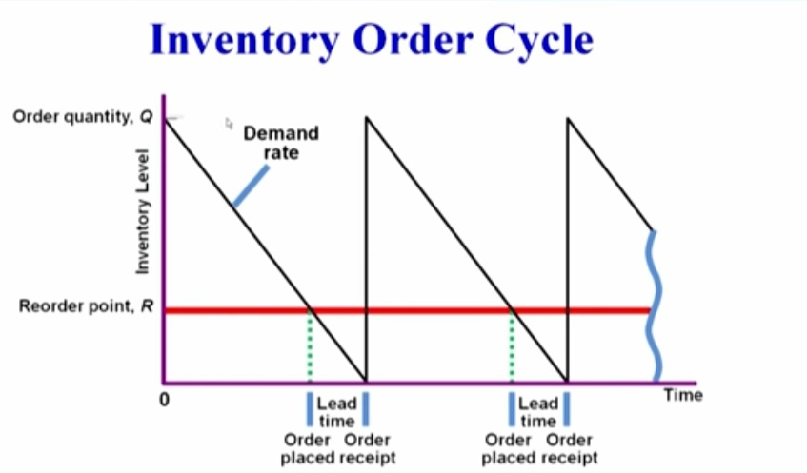

Slide 25
EOQ Cost Model
Co- Cost of placing order D= Annual Demand
Cc= Annual per-unit carrying cost Q = Order quantity
Annual Ordering Cost = CoD
Q
Annual carrying cost= CcQ Total Cost= CoD + CcQ
2 Q 2

Slide 26
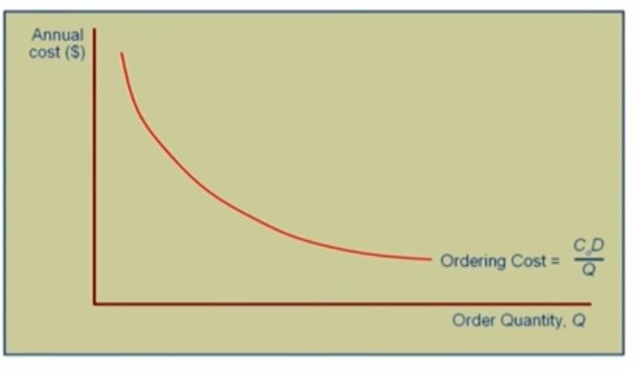

Slide 27
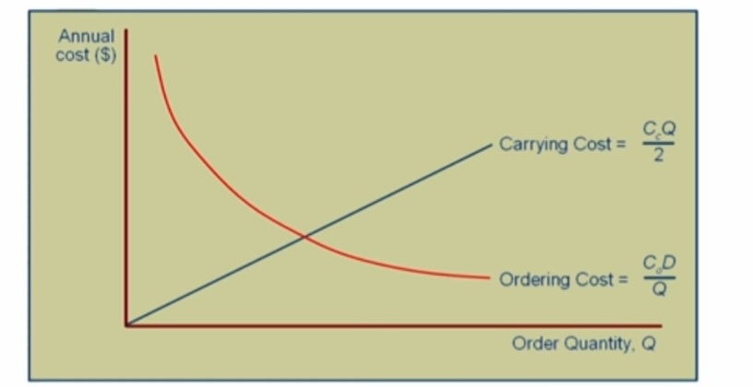

Slide 28
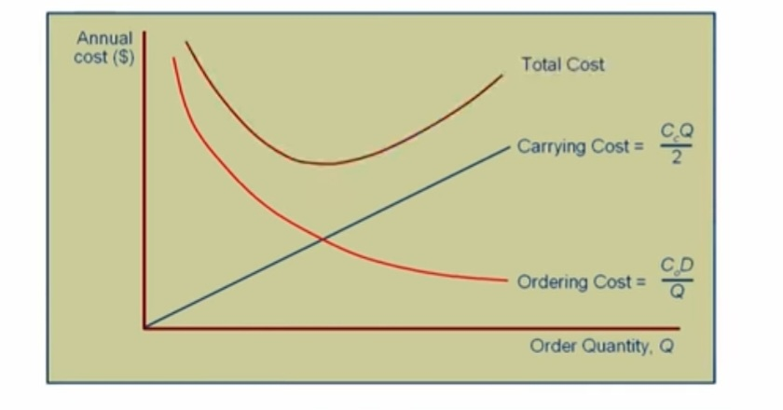

Slide 29
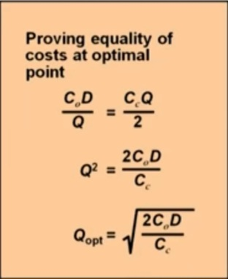

Slide 30
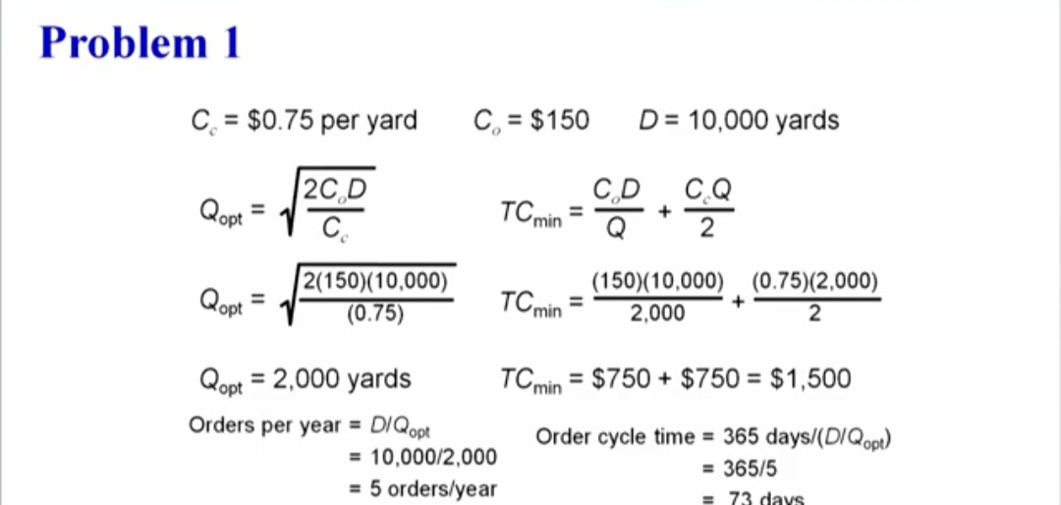

Slide 31
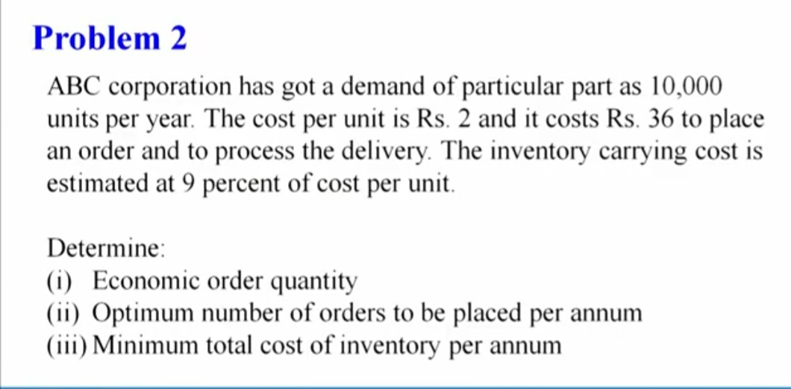

Slide 32
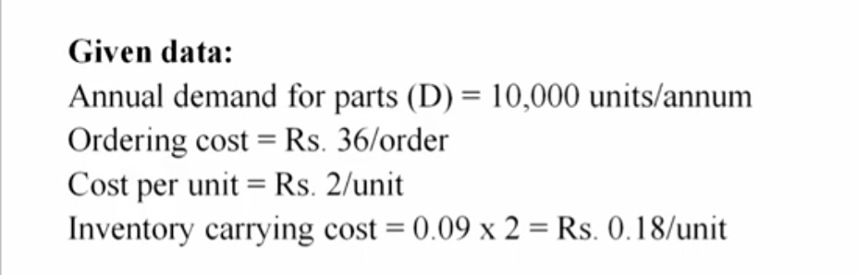
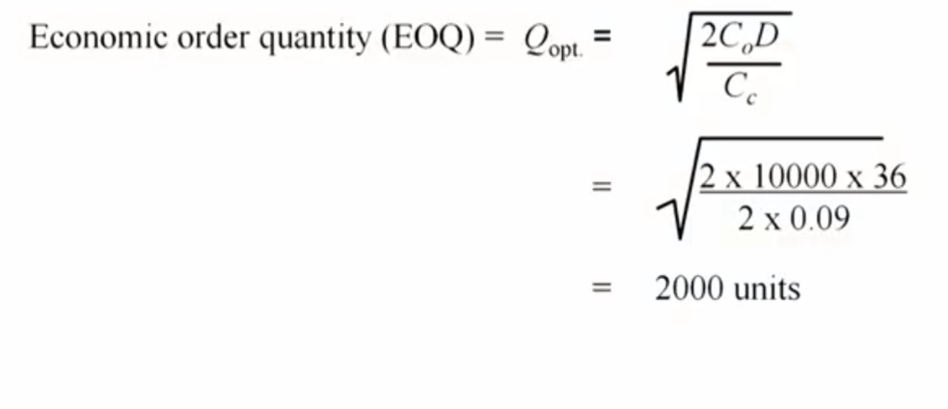
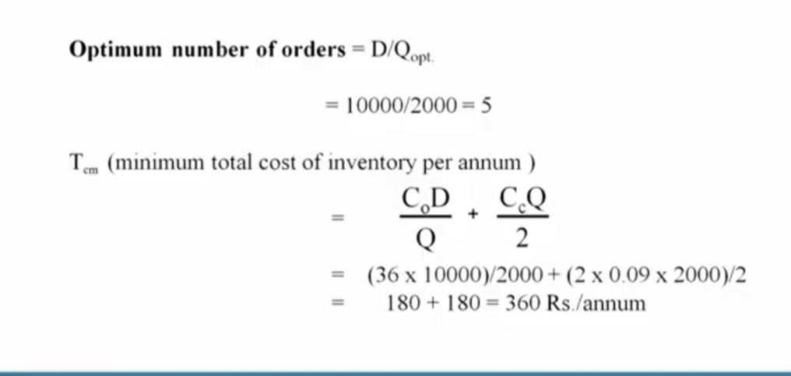

Slide 33
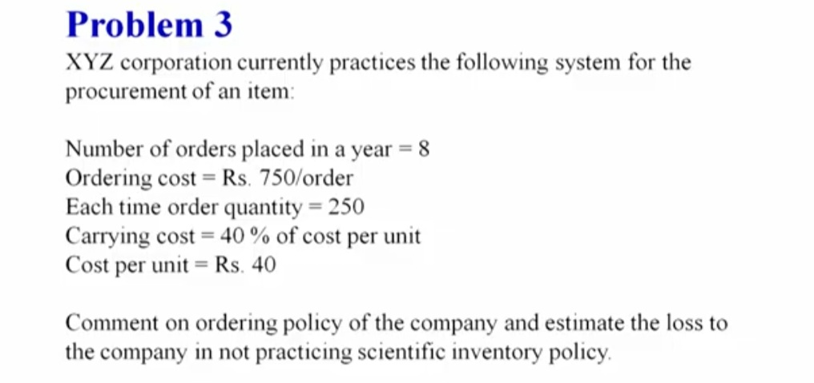

Slide 34
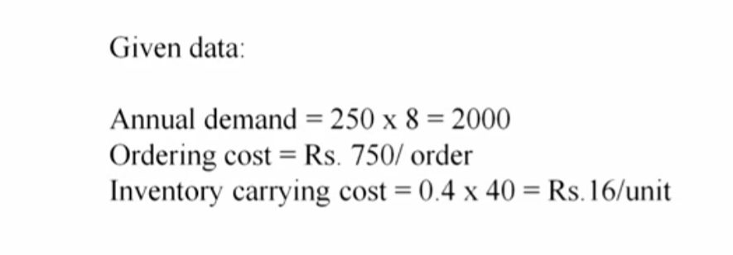
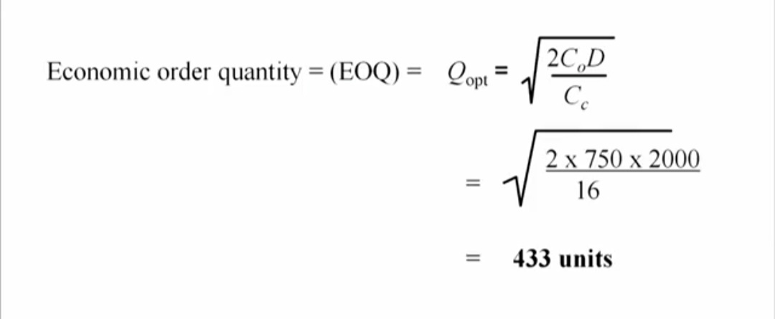

Slide 35
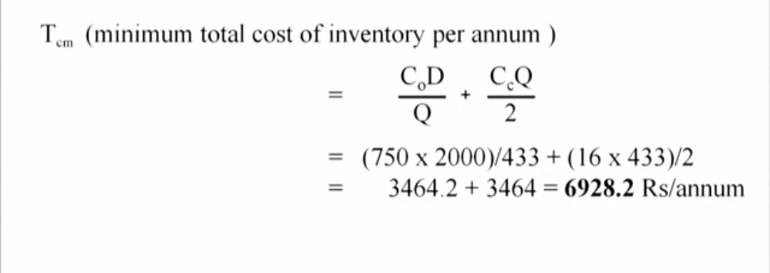
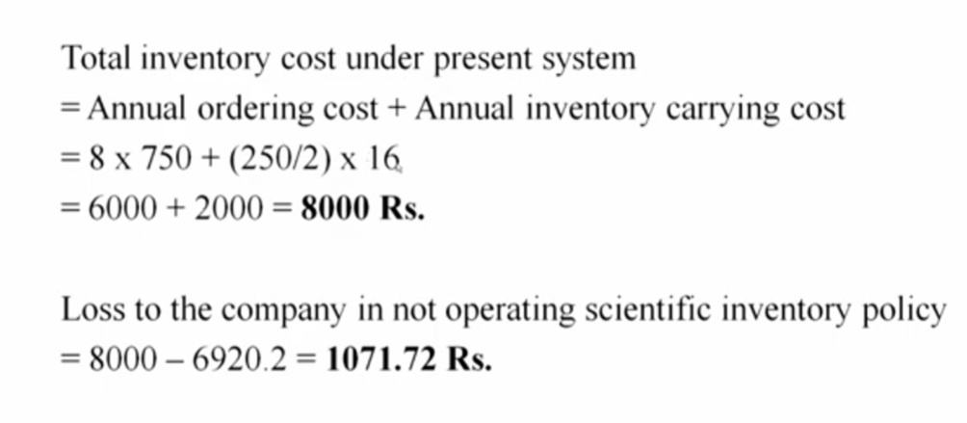

Slide 36
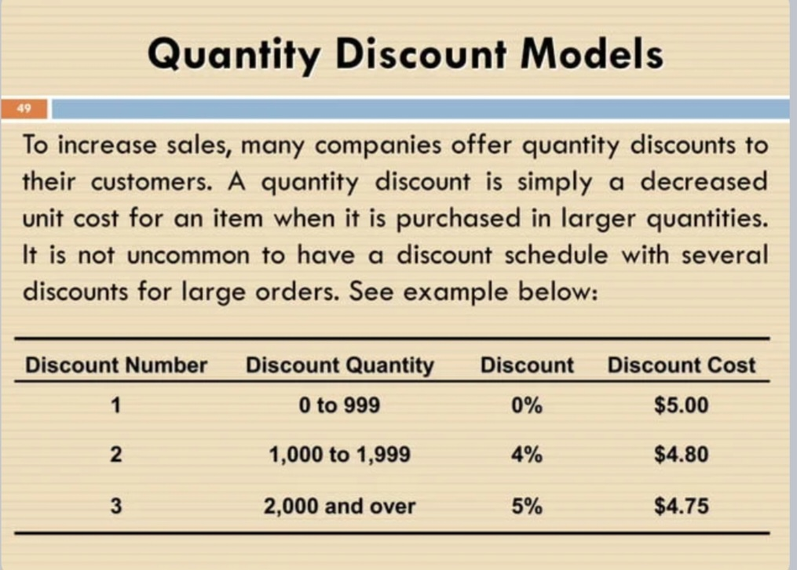

Slide 37
Management must decide when and how much to order. But with quantity discounts , how does a manager make these decisions?
Because of unit cost of third discount is lowest we might tempted to order 2000 units or more to take advantage of this discount
Placing an order for that many units , however , might not minimize the total inventory cost. As the discount quantity goes up, the item cost goes down, but carrying cost increases because the order sizes are large
Thus the major trade-off when considering quantity discounts is between the reduced item cost and the increased carrying cost

Slide 38
Quantity Discount Example
GSB Department store stocks toy cars. Recently, the store was given a quantity discounts as shown in slide 35, thus , the normal cos of car is $5.00. for orders between 1000 to 1999 units , the unit cost is $ 4.80, and for orders of 2000 or more units , the cost is $4.75. furthermore, the ordering cost is $49 per order, the annual demand is 5,000 race cars, and the inventory carrying charge as a percentage of cost is 20%,or 0.2. what order quantity will minimize the total cost

Slide 39
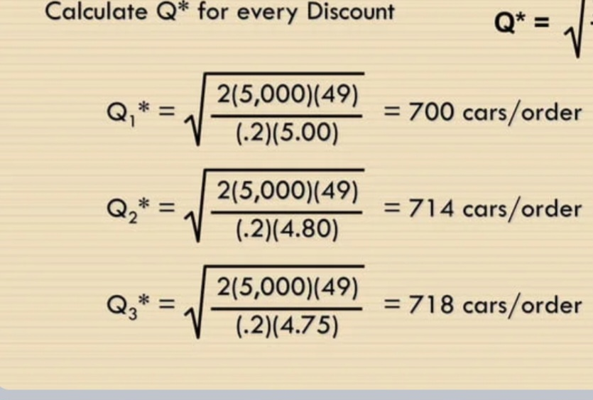

Slide 40
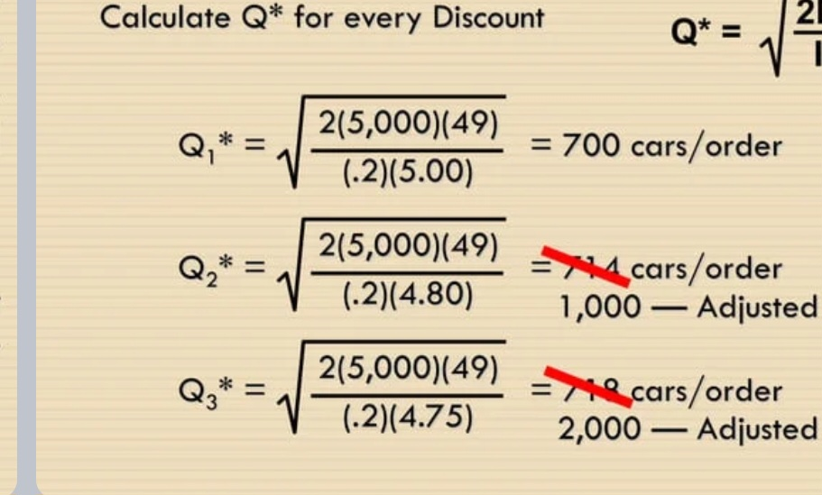

Slide 41
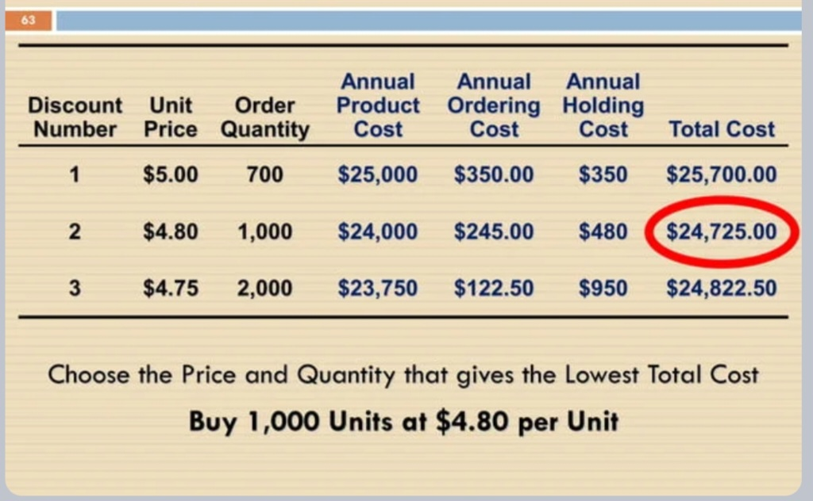

Slide 42
Questions For Continuous internal evaluation
Q.1) What is EOQ ? Explain the different assumptions considered in EOQ model? Discuss EOQ as inventory control technique?
Q 2) Explain ABC and VED analysis in detail
Q.3) Perform ABC analysis on the following sample of items in an inventory
Item | Annual Consumption | Price /unit
1 | 300 | 0.10
2 | 2800 | 0.15
3 | 30 | 0.10
4 | 1100 | 0.05
5 | 40 | 0.05
6 | 220 | 1.00
7 | 150 | 0.05
8 | 800 | 0.05
9 | 600 | 0.15
10 | 80 | 0.10

Slide 43
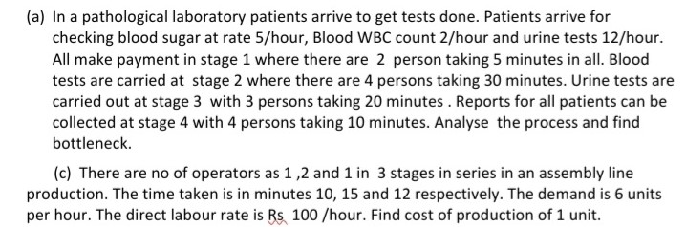
Q.4 Ashish keeps his inventory in special containers. Each container occupies 10 sq.ft. of store space. Only 5000 sq.ft. of the storage space is available. The annual demand for the inventory item is 9000 containers, priced at Rs 8 per container. The ordering cost is estimated at Rs. 40 per order, and the annual carrying costs amount 25 % of the inventory value. Would you recommend to Ashish to increase his storage space? If so , how much should be the increase?
Q 5) Define materials management, explain objectives, scope and responsibility of materials management.
Q.6) Define inventory , explain need of inventory
Q. 7) what are the different types of process? Explain steps involved in Process analysis
Q.8)

Slide 44
THANK YOU

